Slide 1
Prometeruse

Slide 2
Pupils were challenged with quizzes designed to assess their understanding of climate change before and after the project. Congratulations to Saran School in Yazd for their outstanding improvement in quiz score (368.8%).

Slide 3
Groups with similar projects partnered with their peers abroad to implement their projects and produce their videos. Kudos to Sparrows🐦 (IIILO 3D, Poland) & Pronature (Saran High, Iran) and 2 🥔 , 2 🍚 (JGH 9CF) & 🎀🐆🎀(IIILO 2D) for their active interactions.

Slide 4
+ 20 points for partnering with other schools

Slide 5
Pupils had the unique opportunity to interact with expert researchers, gaining insights into their selected projects. These interactions inspired the waste mitigation actions.

Slide 7
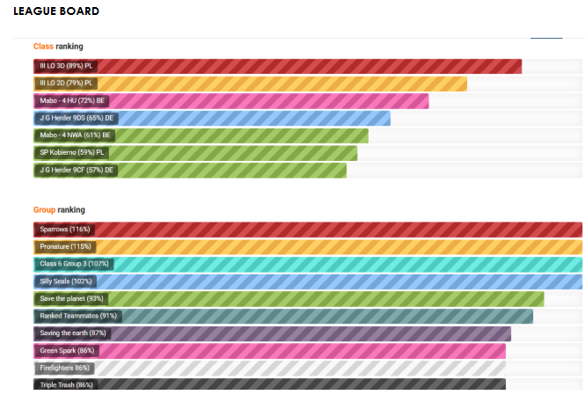

Slide 14
TOP 10 WASTE MITIGATION VIDEOS
Sparrows🐦 (IIILO 3D, Poland) & Pronature (Saran High, Iran)
2 🥔 , 2 🍚 (JGH 9CF) & 🎀🐆🎀(IIILO 2D)
Silly seals Group – IIILO Poznan - 3D
Save the planet Group – IIILO Poznan - 3D
Ranked Teammates – IIILO Poznan -3D
Saving the 🌎✨ Group – MABO - 4HU
Green Spark 🍀😼 Group – Johann-Gottfried-Herder Gymnasium - 9DS
🔥🤛😦firefighters🔥😈😈🎀🎀🎀‼️‼️ Group – (III LO) 2D Poznan
Triple Trash😜 Group – III LO 3D Poznan
Goodfellas 💌 – III LO 2D Poznan

Slide 15
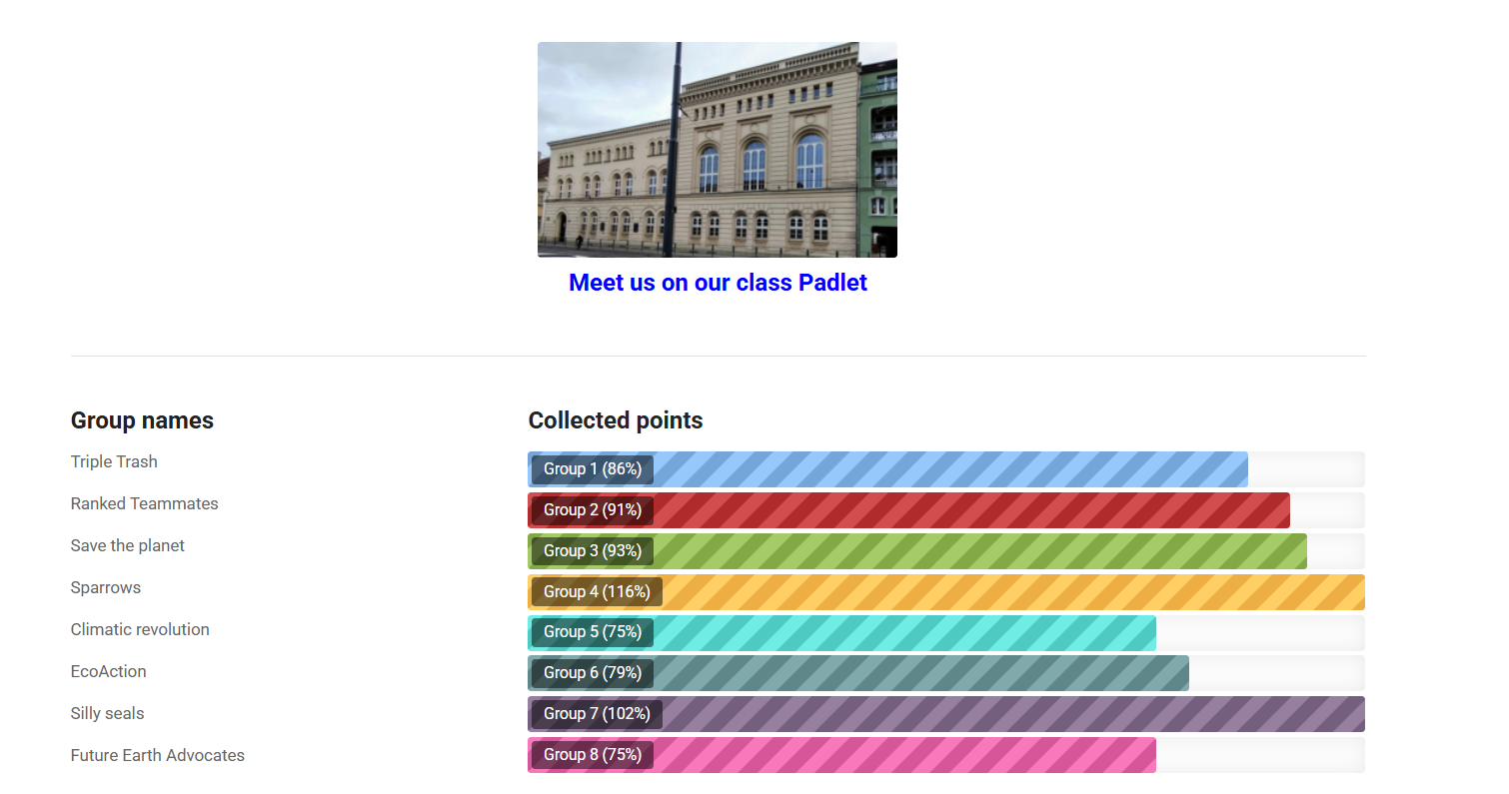

Slide 16
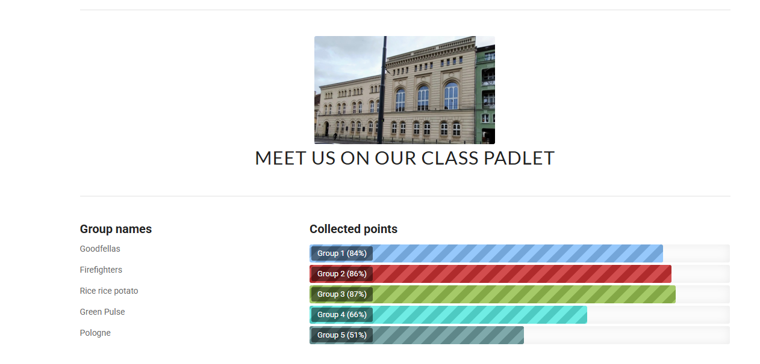

Slide 17
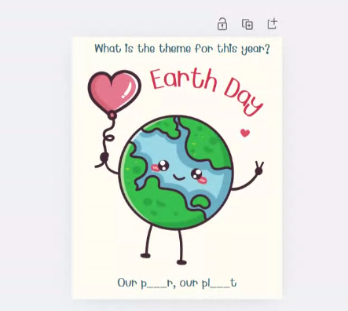

Slide 18
And that’s a wrap!
This wasn’t just about projects and presentations, it was about the laughs shared, the "aha!" moments celebrated, and the kind of ideas that stick with you long after the final deadline.

Slide 19
https://www.prometeruse.org/

